Slide 1

SVM based Vertical Handovers
Presented by -
Anant Sharma (17uec019)
Ayush Maheshwari (17uec034)
Kartik Singhal (17uec062)
Ritik Agarwal (17uec093)
BTP Supervisor -
Mr. Akash Gupta

Slide 2
CONTENTS
Problem Statement
What is LiFi?
LiFi Vs WiFi
Advantages of LiFi
Disadvantages of LiFi
Why LiFi and WiFi?
Types of Vertical Handovers
Immediate Handover
Dwell Handover
SVM- based handover
SVM-A machine learning model
System Model
Necessary System Parameters
LiFi Channel Blockage
Sample Set Construction
Use of SVM Classifier
Simulation & Results
Challenges to Overcome

Slide 3
PROBLEM STATEMENT
With the rapid growth of service demands, data traffic in indoor wireless networks is explosively increasing.
A promising alternative to Wifi is Lifi.
Lifi provides high data rate but it is more easily affected by obstructions which might lead to unstable optical communications.
To provide both high data rate and stable service both LiFi and WiFi is used .

Slide 4
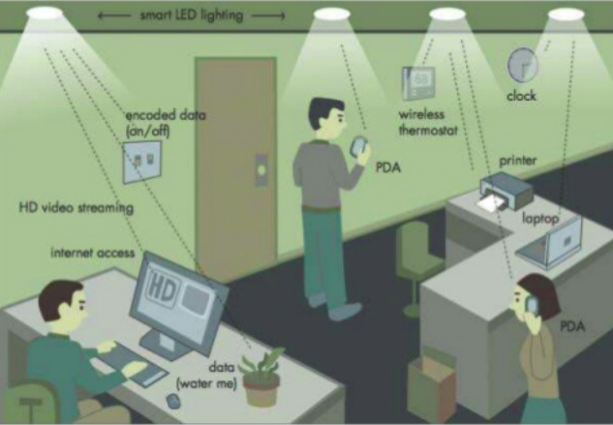
What is LiFi?
LiFi technology is a ground-breaking light-based communication technology, which makes use of light waves instead of radio technology to deliver data.
LiFi can compensate as the radio spectrum becomes overloaded.
Using light to deliver wireless internet will also allow connectivity in environments that do not currently readily support Wi-Fi, such as aircraft cabins, hospitals and hazardous environments.

Slide 5
LiFi VS WiFi
LiFi uses light for data transmission while WiFi uses electromagnetic waves at radio frequencies for data transmission.
LiFi covers distance of about 10 meters while WiFi covers about 30 meters.
LiFi transmits data using light with the help of LED bulbs while WiFi transmits data using radio waves with the help of WiFi routers.
LiFi has less interference & works in densy region while WiFi has more interference & works in less dense region.
Lifi is not the replacement of wifi technology. It can be considered as incredible companion of the wifi technology.
LiFi is used to exchange data incredibly rapidly and securely at much lower power level compare to WiFi.

Slide 6
Advantages of LiFi
Speed-The speed of the Li-Fi is very high, and we can watch the videos without buffering.
Security- The light of the Li-Fi doesn’t run through the partition, therefore, it is more protected and hacking is not possible.
Risk-free-Li-Fi utilizes light waves which are harmless.
Consistent- The data transfer is more protected.

Slide 7
Disadvantages of LiFi
Apart from several benefits, the Li-Fi technology is facing several problems. It requires LOS (line of sight), as well as the receiver, would not be a move in inside.
The main problem is how the receiver will send the data back to the transmitter section.
Another disadvantage of this technology is an interference of exterior light sources such as normal bulbs; sunlight in the lane of communication will cause intermission in the transmission.
It doesn’t work in the dim areas.

Slide 8
Why LiFi and Wifi ?
The only point where LiFi lacks is, how to overcome channel blockage.
This is where WiFi steps forward and helps to provide the continuation of data rate.
To provide high rate and stable service for mobile users, an indoor heterogeneous communication network with LiFi and WiFi has been introduced.
With this approach we can get better performance than either LiFi or WiFi.
Two basic vertical handover schemes are applied in the hybrid network , where vertical handover (VHO) refers to the handover between LiFi
and WiFi.

Slide 9
Types of Vertical Handover
Immediate Vertical Handover (I-VHO)
Dwell Vertical Handover (D-VHO)
Support -Vector-Machine-Based Handover (SVM-Based)

Slide 10
Immediate Handover (I-VHO)
When a LiFi blockage occurs , there occurs an immediate handover between LiFi and WiFi .
The user is switched to WiFi immediately after the occurence of the channel blockage between user and LiFi.
The user will be switched back to LiFi as soon as the blockage disappears and will be disconnected from WiFi.

Slide 11
DWell Vertical Handover(D-VHO)
Though I-VHO can ensure the continuity of service access, frequent handover between LiFi and WiFi could significantly reduce the effective time of data transmission, leading to low equivalent data rate of users. The alternative solution is dwell VHO (D-VHO), where a user waits for a dwell period once the LiFi connection is lost. When the dwell time expires, if the optical link is still unavailable, the user switches to WiFi, otherwise it stays in LiFi. And when the optical link is recovered, the user immediately performs VHO from WiFi back to LiFi.

Slide 12
SVM based vertical handover
D-VHO is not suitable for the case of long-term blockage interruption.
To achieve higher equivalent data rate under various channel blockage situations, we will use svm based handover.
Due to regular movements of indoor users or obstacles,there exists a correlation among blockage parameters in adjacent periods

Slide 13
Hence, a mapping function between the current network access type and previous blockage information exists, which however might be implicit. SVM is capable of learning the mapping function by training

Slide 14
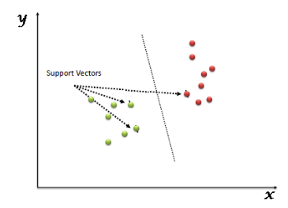
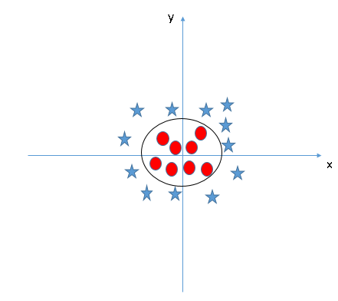
SVM-A machine learning model
In the SVM algorithm, we plot each data item as a point in n-dimensional space with the value of each feature being the value of a particular coordinate. Then, we perform classification by finding the hyper-plane that differentiates the two classes very well.
In the SVM classifier, it is easy to have a linear hyper-plane between these two classes, the SVM algorithm has a technique called the kernel trick, it converts not separable problem to separable problem.
It does some extremely complex data transformations, then finds out the process to separate the data based on the labels or outputs you’ve defined.
As shown in the figure the best fit hyperplane is a circle which most efficiently differentiates the two classes

Slide 15
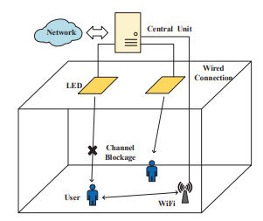
System Model
Important components of our system model are :-
LiFi Access points (Ap) : LEDs are installed on the ceiling and each of them act as LiFi AP.Each user can connect to one Lifi Ap or Wifi Ap at a time.When a Lifi gets blocked by an obstacle user is switched to Wifi.
WiFi : To provide high data rate and stable service a WiFi access point is placed in the corner to provide coverage for the entire room .The wifi data rate remains constant and is denoted as
r^{WiFi}.
Central Unit:central unit in the room decides the network access type for each user according to its channel blockage information.
.

Slide 16

Necessary System Parameters
LiFi channel model : Indoor LiFi channel can be represented by dominant Los channel model.
In this model gain in denoted as H and is given by :-
Here,
m=lambertian index
A_{P}=physical area of receiver
d=distance of LiFi Ap to user Optical receiver

Slide 17

𝜭 = angle of incidence
𝜱 = angle of irradiation
ΘF = half angle of the receiver’s field of view (FOV)
Ts(θ)= gain of the optical filter
g(θ)= concentrator gain

Slide 18

When a user µ is connected to the LiFi AP α, its signal-to interference-plus-noise ratio (SINR) can be expressed as
γ = optical to electrical conversion efficiency
P_{t} = optical power of the transmitted signals at each LiFi AP
N_{O} = noise power spectral density
B = modulation bandwidth of the LED
H_{μ,α}=optical channel gain between user µ and LiFi AP α
H_{μ,else} = optical channel gain between user µ and all the other LiFi APs

Slide 19

We will use the above formula of SINR to calculate the achievable data rate between user µ and LiFi AP α .
Data rate of LiFi is given by:-

Slide 20
LiFi Channel Blockage
There are two key parameters to measure LiFi channel blockage :-
Occurrence rate ( λ ) :- Describes the times of channel blockages happened during the period T.
Occupation rate ( η ) :- Ratio between the period of time when a user experiences channel blockage and T
Here,
T= short period during which LiFi channel blockage parameters of users remain constant

Slide 21



Sample Set Construction
The Equivalent data rate consists of , the data transmission rate achieved by the WiFi and LiFi.
where , T_{H} denote the ratio between a single vertical handover overhead and the time interval T .
The label y is selected from the index set of network access type, which is denoted as {κ}.
The central unit will select the access type with the highest equivalent data rate as the sample label y for state n, which is expressed by :-
where 𝓚=1 for “WiFi only” ,
𝓚=2 for “LiFi only” ,
𝓚=3 for “LiFi/WiFi” .

Slide 22


To Train and test SVM model , a large number samples are required . Specifically , a sample can be expressed as :-
Where , x is the sample input vector and y is the sample label indicating the optimal network access type .
x include blockage occurrence rate λ_{n-1} , the blockage occupation rate η_{n-1} and the current LiFi transmission rate r_{n}^{LiFi} .
The equivalent data rate achieved by the user with access type 𝓚 is given by :-

Slide 23
Use of SVM classifier
In this case our built sample set is linearly inseparable, hence a kernel functions is adopted to transform a nonlinear problem into a linear problem, which is capable of mapping the SVM training samples from the original space to the high-dimensional space where the samples are linearly separable.
Since this is a multiclass problem(three-classification) so we need to use LIBSVM.
In LIBSVM, radial basis function (RBF) is adopted as the kernel function. The optimal values of RBF parameters are selected by cross validation.
During the training phase, the sample input vector is the ternary parameter group x, which is preprocessed by normalization. The sample label is the network access type y, in the central unit. The training process of the SVM model can learn the mapping relation between x and y.
Since the parameters of the trained SVM model have been stored in the central unit, after getting the input vector from a user, the central unit can determine the output network access type quickly and feed it back to the user.

Slide 24
Simulation & Results

Slide 25
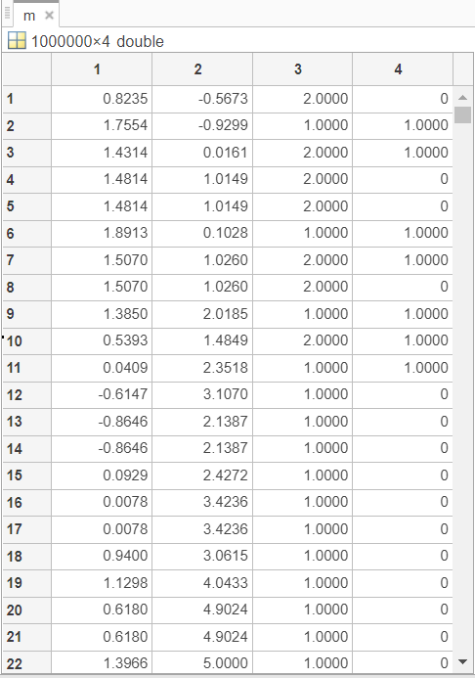
1. Getting the data points for Immediate Handover
At the initial stage of our project we used two wifi modules and created random coordinates in a room and just decided on the basis of euclidean distance for deciding which wifi module should be used. This handover process was immediate without considering any overheads or blockage parameters.

Slide 26
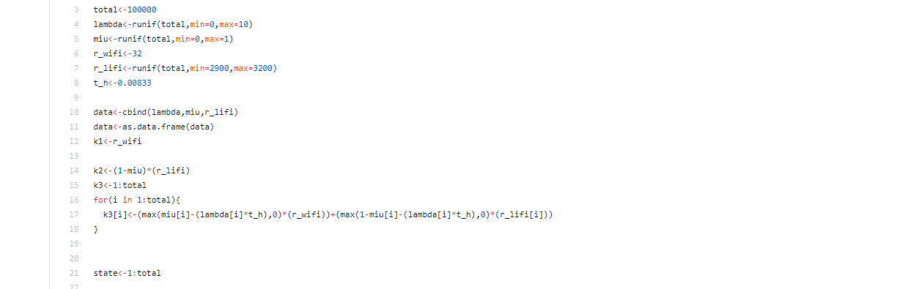
2. R code ( SVM Based )

Slide 27
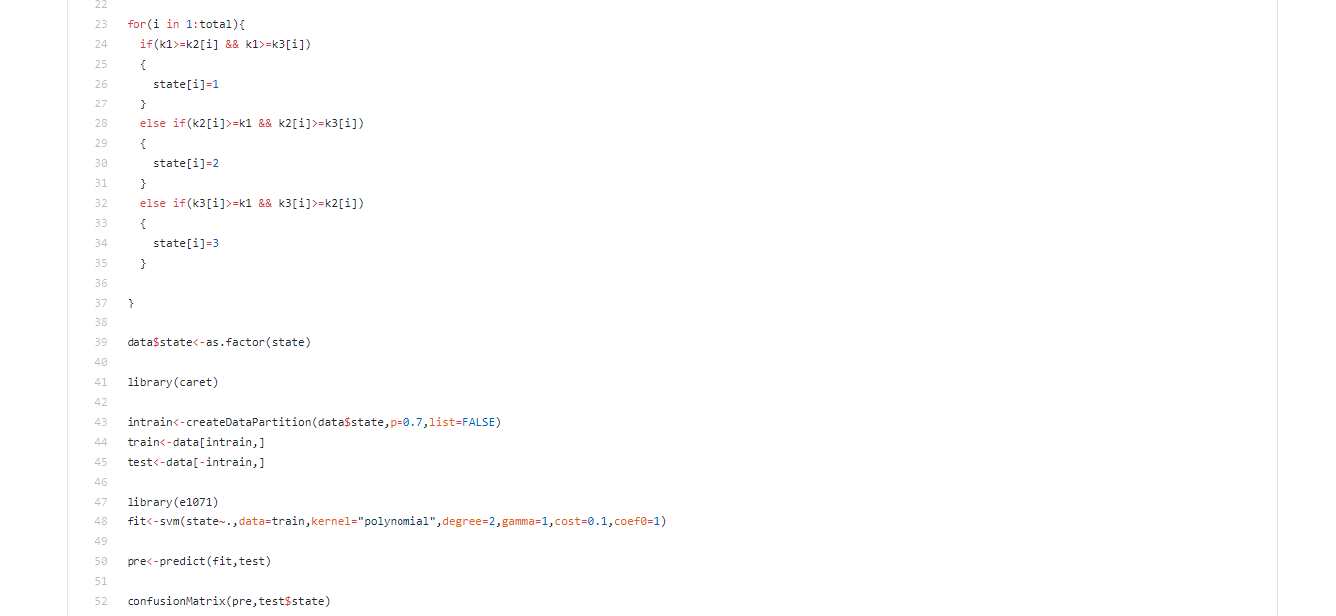

Slide 28
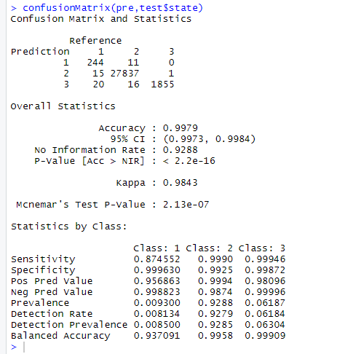
3. Confusion
Matrix
Our SVM model with polynomial kernel gave us an accuracy of 99 percent. We compared the R Squared values of both train and test dataset and it was close to zero indicating no overfitting.
For model building we used grid search to find all the hyperparameters of the SVM classifier and all attributes were equally important for model creation which was confirmed by the CHI square test.

Slide 29
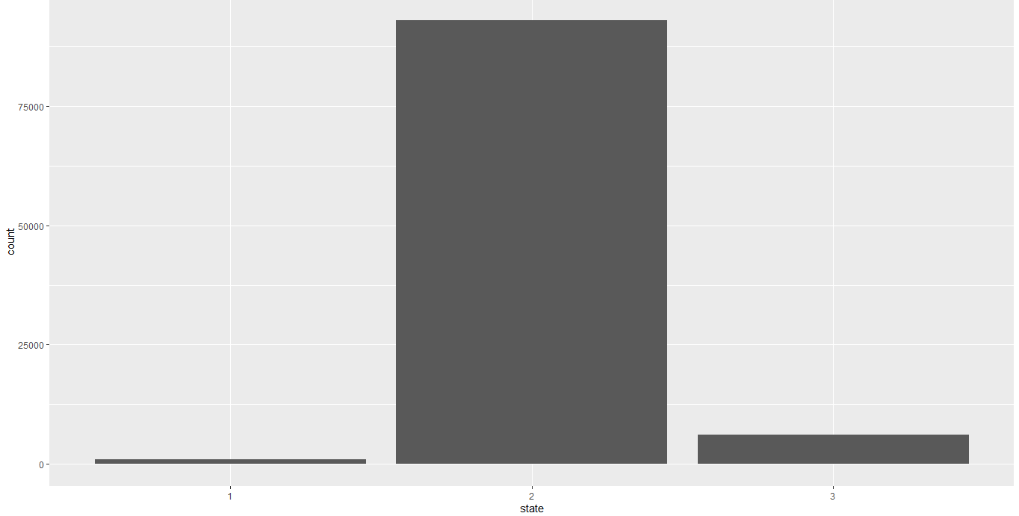
4. Graphical representation of states
We plotted a histogram of states ( k=1, k=2,k=3).The frequency of k=2 (lifi) is maximum and k=3 (handover state) is very less (6 percent) indicating that our model is ensuring high data rate and minimum no of handovers.
K=1 K=2 K=3

Slide 30
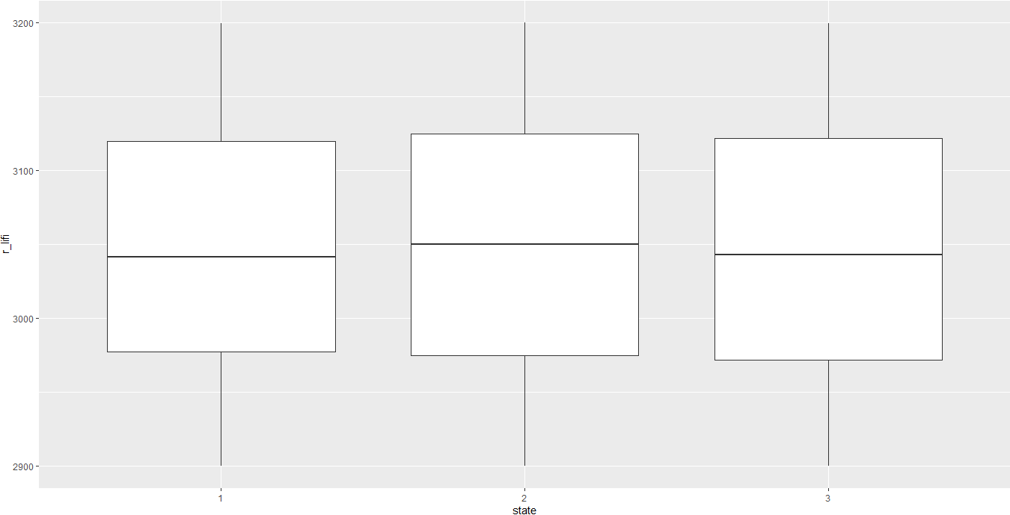
5. Relation between r^{lifi} and state of connection
As r^{lifi} (data rate of lifi) increases ,we can see a rise in k=2(lifi only) states. This means that our svm model is correctly predicting the state of connection as high lifi transmission should obviously imply that we should be using LIFI for data transmission.

Slide 31
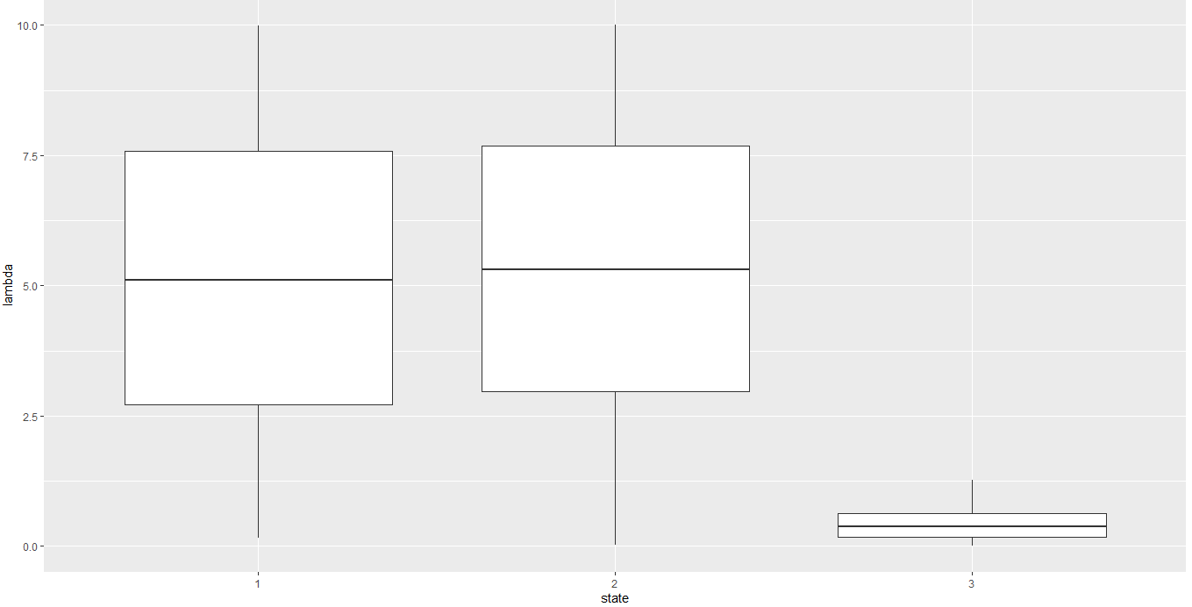
6. Relation between occurrence rate and state
Occurrence rate indicates blockage faced by Lifi. So if they increases LiFi data rate decreases and therefore k=1(wifi state increases).

Slide 32
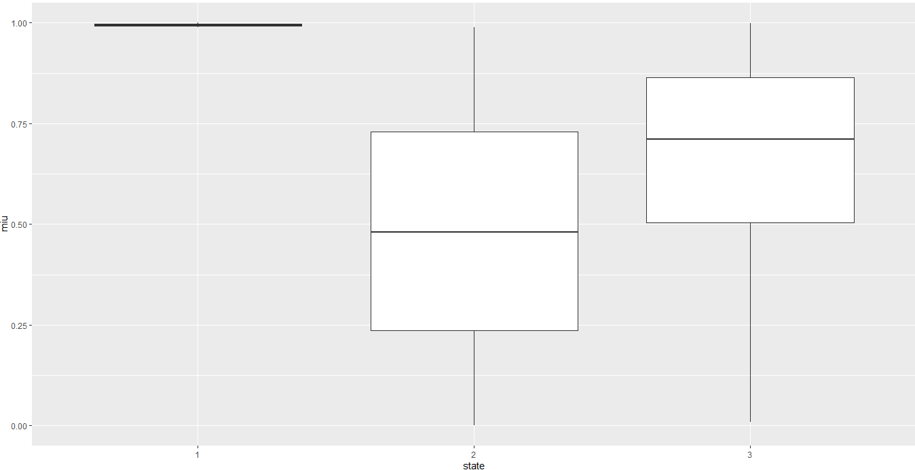
7.Relation between occupation rate and state
Similar to occurrence rate and occupation rate will also have same effect on the state.

Slide 33
Challenges to Overcome
We intend to use the coordinates of the room as input vector to determine the state of our system but we were not able to so because we don’t know yet the practical relation between blockage parameters and the coordinates of room.
We used random values to determine occupation, occurence rate and lifi transmission values but we have to take practical values by measuring them at each coordinate in a room and then extracting the data from it but due to the lockdown we didn't had proper equipments with us to do so.
We are yet to compare the results from WIFI only and WIFI-LIFI model, we were not able to do so because we didn’t have any practical values so it would be unfair to compare the models based on random values.
We would also want to try to reduce the number of handovers in our dataset further once we have proper equipments to extract the dataset.

Slide 34

THANK YOU

